Slide 2
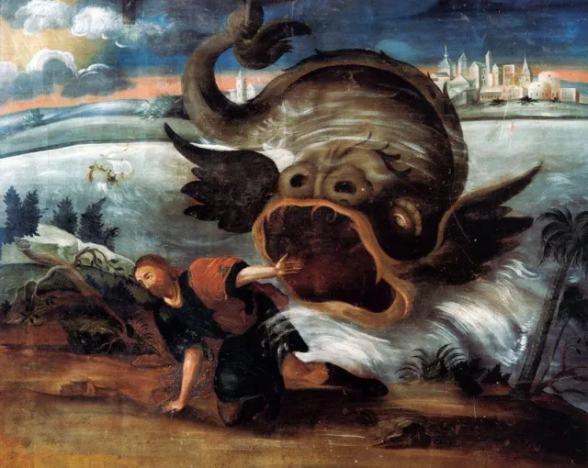
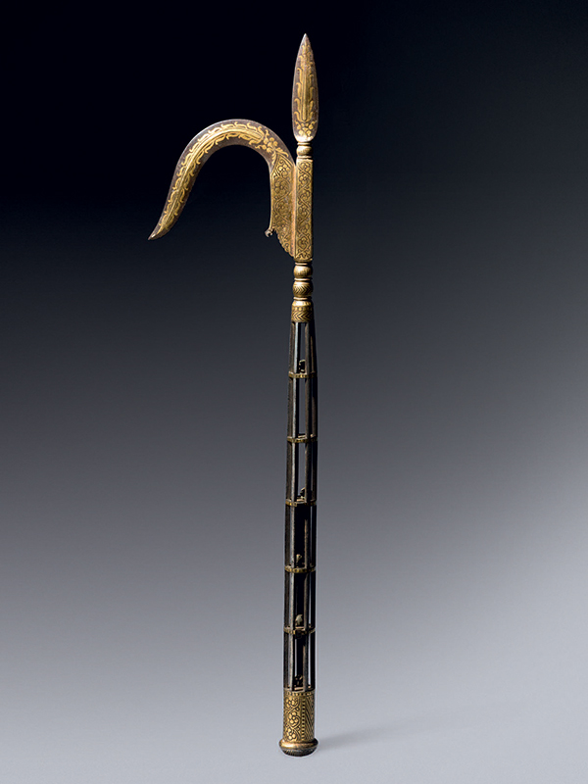

Slide 3
TRYING TO RUN AHEAD OF GOD
Psalm 27:14 “wait…on the Lord”
Acts 9:5 “hard to kick against the goads”

Slide 4
SARAH OFFERING HAGAR TO ABRAHAM
God promised Abraham descendants – Genesis 12:7
He was without children, wife barren
He was about 100 years old! - Romans 4:19
Ten years after promise, Sarah gave Abraham to her hand maid, Hagar – Genesis 16:1-3

Slide 5
SARAH OFFERING HAGAR TO ABRAHAM
Hagar conceived by Abraham
She began to feel superior to Sarah
Sarah began to put blame on Abraham
With his permission she began to mistreat Hagar and she ran away (Genesis 16:4-6)
Angel appeared to Hagar told her to submit to Sarah

Slide 6
SARAH OFFERING HAGAR TO ABRAHAM
Said her son was to be the father of a multitude and he would be an adversary to all men (Genesis 16:7-12)
God kept promise to Abraham and Isaac was born.
Hagar and her son Ishmael driven out for good (Genesis 21:8-21)

Slide 7
SARAH OFFERING HAGAR TO ABRAHAM
Sarah:
  Lost her patience
  Stopped walking by faith
  Sought a fleshly solution
Instead of “waiting on God” she took matters into her own hands
How much better things would have been if she had “waited on God?”

Slide 8
KING SAUL OFFERING SACRIFICE IN PLACE OF SAMUEL
1 Samuel 13:5-7
Samuel told Saul to wait until he came to offer a sacrifice to the Lord
Saul saw desperate circumstances and decided that he could not wait (1 Samuel 13:8-15)
Samuel arrived and confronted him about his decision – Saul he felt “compelled” (1 Samuel 13:12)

Slide 9
KING SAUL OFFERING SACRIFICE IN PLACE OF SAMUEL
“You have done foolishly.” 1 Samuel 13:13
Faith took a back seat to Fear
Felt compelled to “help God”
How many blessings have we lost because we have failed to wait on God to do things in His own time?

